Slide 1

Walchand College of Engineering, Sangli
Department of Information Technology
A
DP-II
Presentation on
Performance evaluation of Fruit Fly Optimization
Algorithm on classical test problem set
Broad Topic: Engineering Optimization
Sub Topic: Evolutionary Algorithm
By Guide
Atul J. Kamble Dr. A. J. Umbarkar
M. Tech - II CSE(IT)

Slide 2
Outlines
Introduction
Research Objectives
Literature Survey
Research Gap
FFOA
Test Problem Set
Experimental Setting
Result
References

Slide 3
Research Objectives
To implement FFOA to the classical test problem sets (CEC 2013) (100%)
To check the analysis of result of classical test problem.
To apply FFOA for engineering optimization problem.

Slide 4
Literature Survey
Sr. No. | Authors | Work carried out
1 | J. Q. Li, Q. K. Pan and K. Mao(2016) | A Hybrid Fruit Fly Optimization Algorithm : Realistic Hybrid Flowshop Rescheduling Problem in Steelmaking Systems.
2 | R. X. L. Zheng and L. Wang (2016) | A Collaborative Multiobjective Fruit Fly Optimization Algorithm : Resource Constrained Unrelated Parallel Machine Green Scheduling Problem.
3 | K. Wu, J. Kang and X. Wang(2016) | Based on Improved Fruit Fly Algorithm and Grey Fast Relevance Vector Machine: Failure Prognostics Method of Electronic System
4 | K. Ohnishi, A. Fujiwara and M. Koeppen (2016) | Non-swarm intelligence search algorithm based on the foraging behaviors of fruit flies.
5 | Qingfeng Ma, Yuzhu He and Fuqiang Zhou, (2016) | Multi-objective fruit fly optimization algorithm : Test point selection.

Slide 5
Research Gap
Fruit Fly Optimization Algorithm was not tested on CEC test Benchmark Problem Set.
To Solve Truss bar, Gear Design Problem.

Slide 6
Introduction
Fruit Fly Optimization Algorithm (FFOA)
Proposed by (Pan,2012).
Inspired by the foraging behavior of fruit flies(Drosophila).
Has the ability to solve Complex Optimization Problems
Search pattern of fruit fly includes in sensitive osphresis [1] and flying towards location by vision.
Fig 1 : Drosophila body structure diagram[9]

Slide 7
Fruit Fly Optimization Algorithm
FOOD
Fly1(x1,y1)
Fly 2(X2,Y2)
Fly 3(X3,Y3)
(0,0)
Fig 2 : Schematic diagram of iterative search for food of fruit fly swarm

Slide 8
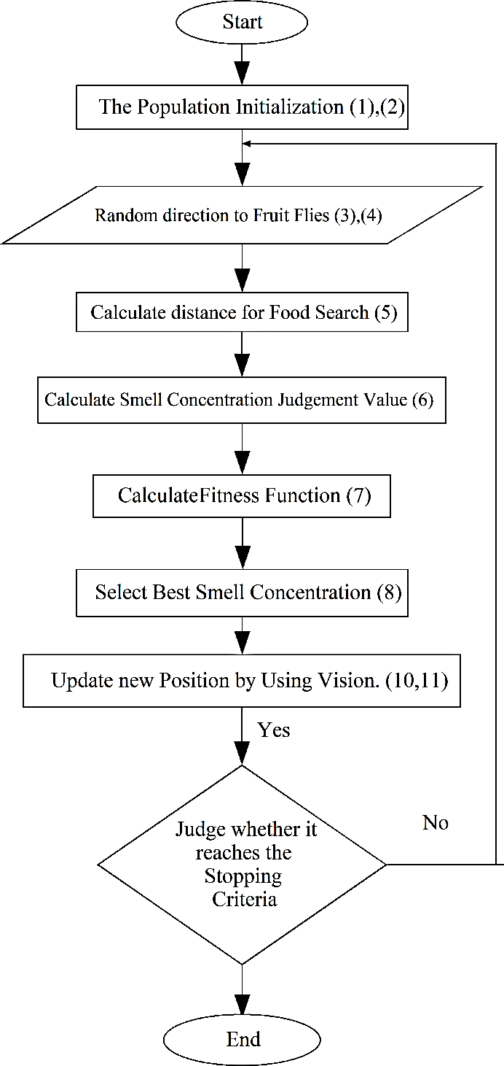
Fig 3: Flowchart of FFOA

Slide 9
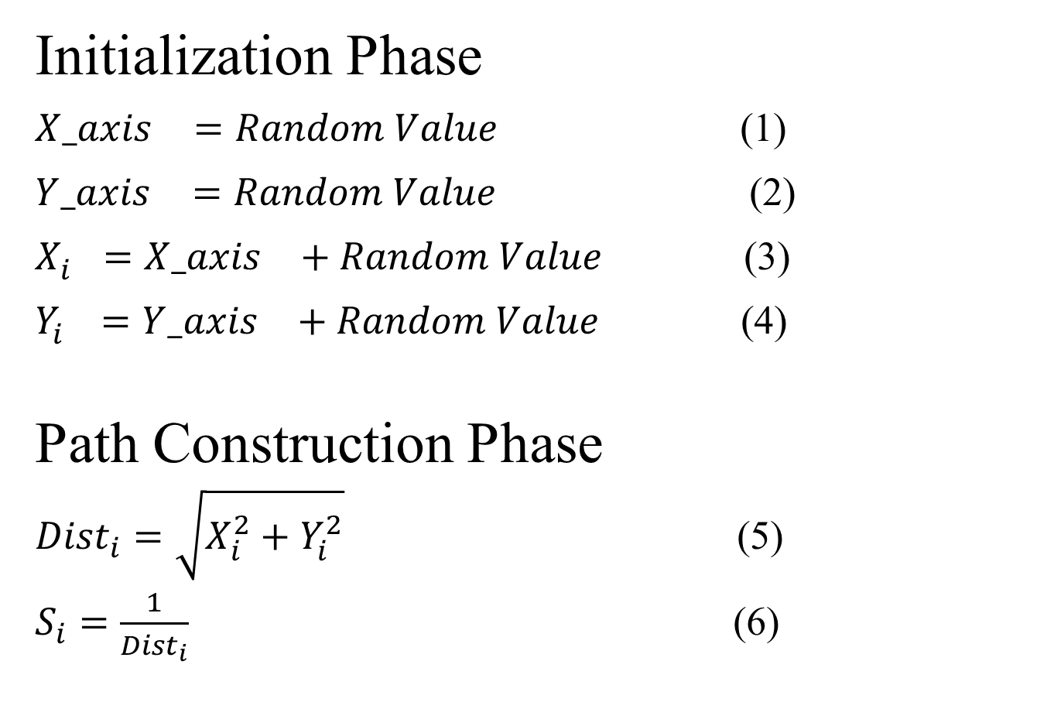
FFOA
Initialization Phase
${X_axis}_{}^{}=Random Value$ (1)
${Y_axis}_{}^{}=Random Value$ (2)
$X_{i}^{}={X_axis}_{}^{}+Random Value$ (3)
$Y_{i}^{}={Y_axis}_{}^{}+Random Value$ (4)
Path Construction Phase
${Dist}_{i}=\sqrt{X_{i}^{2}+Y_{i}^{2}}$ (5)
$S_{i}=\frac{1}{{Dist}_{i}}$ (6)

Slide 10
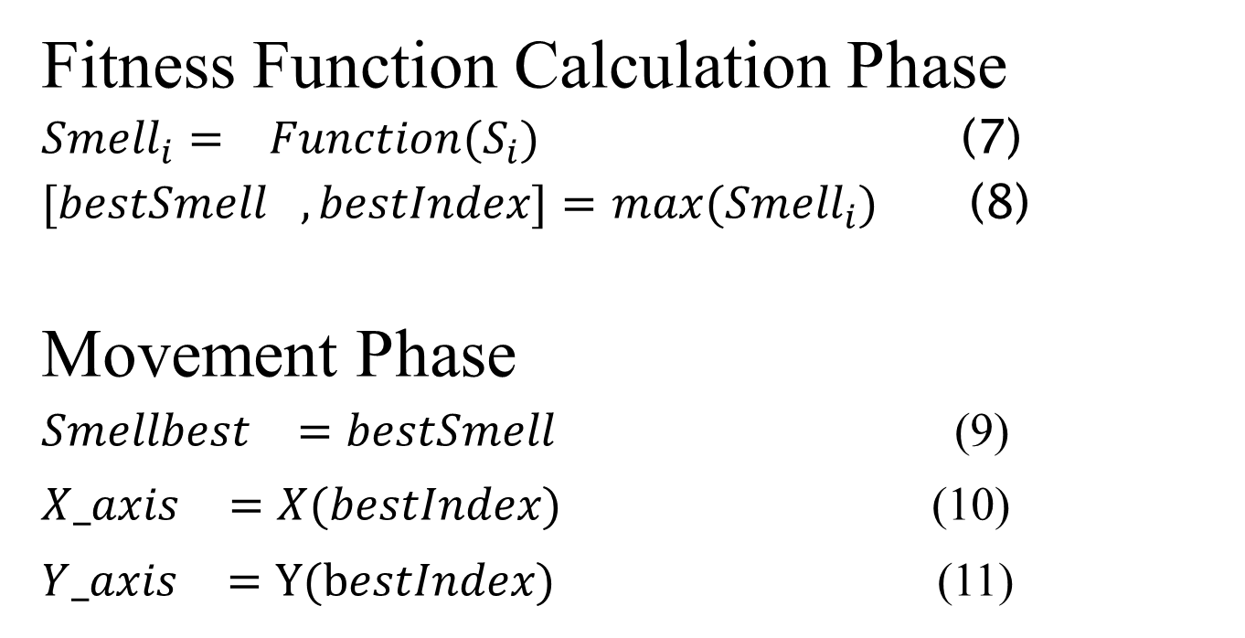
FFOA
Fitness Function Calculation Phase
${Smell}_{i}=$ ${Function(S}_{i})$ (7)
${[bestSmell}_{},bestIndex]=$ ${max(Smell}_{i})$ (8)
Movement Phase
${Smellbest}_{}=bestSmell$(9)
${X_axis}_{}^{}=X(bestIndex)$ (10)
${Y_axis}_{}^{}=Y(bestIndex)$ (11)

Slide 11
Summary of CEC’13 Expensive Optimization Test Problems
 | No. | Functions | f_{i}*=f_{i}(x*)
Unimodal Functions | 1 | Sphere Function | -1400
 | 2 | Rotated High Conditioned Elliptic Function | -1300
 | 3 | Rotated Bent Cigar Function | -1200
 | 4 | Rotated Discus Function | -1100
 | 5 | Different Powers Function | -1000
 |  | Search Range: [-100,100]^{D}
Table 1: Summary of CEC’13 Expensive Optimization Test Problems

Slide 12
Summary of CEC’13 Expensive Optimization Test Problems
 | No. | Functions | f_{i}*=f_{i}(x*)
Basic Multimodal Functions | 6 | Rotated Rosenbrock’s Function | -900
 | 7 | Rotated Schaffers F7 Function | -800
 | 8 | Rotated Ackley’s Function | -700
 | 9 | Rotated Weierstrass Function | -600
 | 10 | Rotated Griewank’s Function | -500
 | 11 | Rastrigin’s Function | -400
 | 12 | Rotated Rastrigin’s Function | -300
 | 13 | Non-Continuous Rotated Rastrigin’s Function | -200
 | 14 | Schwefel's Function | -100
 | 15 | Rotated Schwefel's Function | 100
 | 16 | Rotated Katsuura Function | 200
 | 17 | Lunacek Bi_Rastrigin Function | 300
 | 18 | Rotated Lunacek Bi_Rastrigin Function | 400
 | 19 | Expanded Griewank’s plus Rosenbrock’s Function | 500
 | 20 | Expanded Scaffer’s F6 Function | 600
 |  | Search Range: [-100,100]^{D}
Table 2: Summary of CEC’13 Expensive Optimization Test Problems

Slide 13
Summary of CEC’13 Expensive Optimization Test Problems
 | No. | Functions | f_{i}*=f_{i}(x*)
Composition Functions | 21 | Composition Function 1 (n=5,Rotated) | 700
 | 22 | Composition Function 2 (n=3,Unrotated) | 800
 | 23 | Composition Function 3 (n=3,Rotated) | 900
 | 24 | Composition Function 4 (n=3,Rotated) | 1000
 | 25 | Composition Function 5 (n=3,Rotated) | 1100
 | 26 | Composition Function 6 (n=5,Rotated) | 1200
 | 27 | Composition Function 7 (n=5,Rotated) | 1300
 | 28 | Composition Function 8 (n=5,Rotated) | 1400
 |  | Search Range: [-100,100]^{D}
Table 3: Summary of CEC’13 Expensive Optimization Test Problems

Slide 14
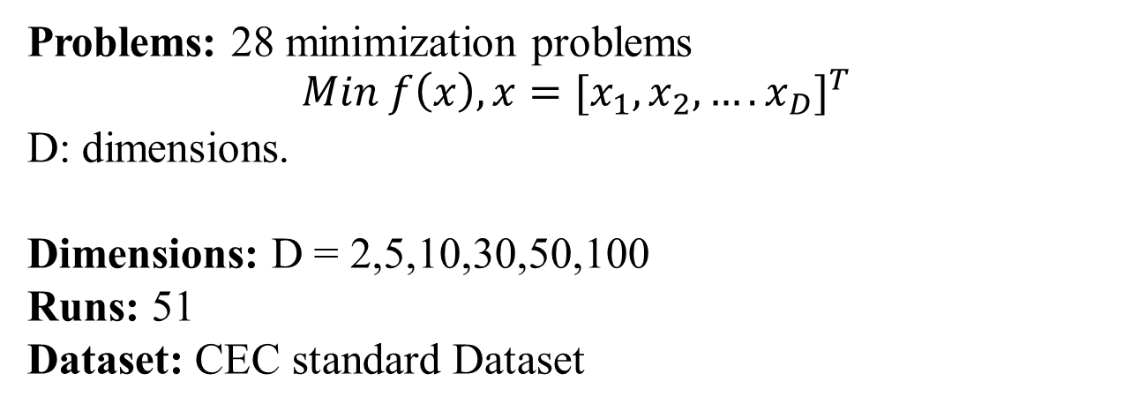
Experimental Setting
Problems: 28 minimization problems
$$Min f\left(x\right), x={{[x}_{1},x_{2},….x_{D}]}^{T}$$
D: dimensions.
Dimensions: D = 2,5,10,30,50,100
Runs: 51
Dataset: CEC standard Dataset

Slide 15
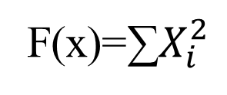
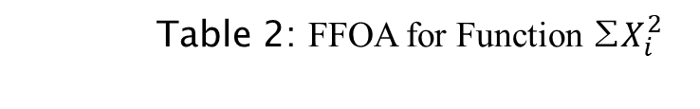
FFOA for Function ∑$X_{i}^{2}$
F(x)=∑$X_{i}^{2}$
Fitness Function =
X_axis | Y_axis | x(i) | y(i) | d(i) | s(i) | smell(i)
3 | 2 | 4 | 3 | 5 | 0.2 | 0.04
4 | 3 | 5 | 4 | 6.4 | 0.156 | 0.0244
Table 2: FFOA for Function ∑$X_{i}^{2}$

Slide 16
Result:10D FFOA for CEC 2013
Fig 3 : FFOA for CEC 2013 (10D)

Slide 17
2-D RESULT
(POPULATION 50 MAX ITERATION 2000)
Function No. | f_{i}*=f_{i}(x*) | Best | Worst | Mean | Std
1 | -1400 | -1400 | -1400 | -1400 | 0
2 | -1300 | -1300 | -1297.9 | -1299.58 | 0.93849
3 | -1200 | -1200 | -1200 | -1200 | 5.81378E-06
4 | -1100 | -1100 | -1099.99 | -1100 | 0.005511
5 | -1000 | -1000 | -1000 | -1000 | 0
6 | -900 | -890.18 | -818.52 | -875.85 | 32.04
7 | -800 | -800 | -799.778 | -799.92 | 0.10
8 | -700 | -679.6 | -679.50 | -679.549 | 0.04
9 | -600 | -599.87 | -598.05 | -598.99 | 0.75
10 | -500 | -499.99 | -499.91 | -499.94 | 0.02
11 | -400 | -398.01 | -394.87 | -397.38 | 1.40
12 | -300 | -298.01 | -294.03 | -296.02 | 1.57
13 | -200 | -196.29 | -179.13 | -189.50 | 6.75
14 | -100 | -196.29 | -179.13 | -189.50 | 6.75
15 | 100 | 756.26 | 1072.27 | 885.37 | 131.28
16 | 200 | 200.55 | 201.00 | 200.8 | 0.16
17 | 300 | 311.58 | 314.49 | 312.99 | 1.22
18 | 400 | 423.67 | 429.50 | 426.25 | 2.14
19 | 500 | 500.46 | 500.70 | 500.60 | 0.11
20 | 600 | 600.93 | 602.61 | 601.80 | 0.60
21 | 700 | 1100.19 | 1100.19 | 1100.19 | 0
22 | 800 | 979.58 | 1296.04 | 1105.77 | 139.85
23 | 900 | 1154.35 | 1907.13 | 1572.76 | 319.12
24 | 1000 | 1200.00 | 1214.26 | 1204.73 | 6.61
25 | 1100 | 1300.01 | 1313.32 | 1307.20 | 6.61
26 | 1200 | 1302.98 | 1508.74 | 1365.68 | 89.65
27 | 1300 | 1600 | 1600.03 | 1600.01 | 0.01
28 | 1400 | 1500 | 1700 | 1660 | 89.44
Table 3: 2-D RESULT FOR CEC 2013

Slide 18
Work Progress
DP- I :- Work Completed
Synopsis
Problem Statement
DP- II :- Work Completed
Objective 1 : Implementation of FFOA to CEC 2013. (90%)
Objective 2 : Analysis on FFOA Algorithm with CEC13 etc (10%)

Slide 19
Work Progress
DP- III :- Work to be Completed
To check FFOA on CEC 2013,2015,2017 Result Analysis.
To Select Engineering Optimization Problem and Solve using FFOA.
Result analysis of all calculations.
DP- IV :- Work to be Completed
Publish Paper
Overall Result
Report Writing
Additional Engineering Optimization problem solving if possible.

Slide 20
References
[1] J. Q. Li, Q. K. Pan and K. Mao,” A Hybrid Fruit Fly Optimization Algorithm for the Realistic Hybrid Flowshop
Rescheduling Problem in Steelmaking Systems,” in IEEE Transactions on Automation Science and
Engineering, vol. 13, no. 2, pp. 932-949, April 216.
doi:10.1109/TASE.2015.2425404
URL: http://ieeexplore.ieee.org/stamp/stamp.jsp?tp=&arnumber=7106574&isnumber=7447676
[2] X. L. Zheng and L. Wang, "A Collaborative Multiobjective Fruit Fly Optimization Algorithm for the Resource
Constrained Unrelated Parallel Machine Green Scheduling Problem," in IEEE Transactions on Systems, Man,
and Cybernetics: Systems, vol. PP, no. 99, pp. 1-11. doi:10.1109/TSMC.2016.2616347
URL: http://ieeexplore.ieee.org/stamp/stamp.jsp?tp=&arnumber=7605452&isnumber=6376248
[3] K. Wu, J. Kang and X. Wang, "Research on Failure Prognostics Method of Electronic System Based on
Improved Fruit Fly Algorithm and Grey Fast Relevance Vector Machine," 2016 International Conference
on Intelligent Networking and Collaborative Systems (INCoS), Ostrawva, 2016, pp. 94-98. doi:10.1109/INCoS.2016.65
URL: http://ieeexplore.ieee.org/stamp/stamp.jsp?tp=&arnumber=7695155&isnumber=7695003
[4] K. Ohnishi, A. Fujiwara and M. Koeppen, "Non-swarm intelligence search algorithm based on the foraging
behaviors of fruit flies," 2016 IEEE Congress on Evolutionary Computation (CEC), Vancouver, BC, 2016,
pp. 1509-1516. doi:10.1109/CEC.2016.7743968
URL: http://ieeexplore.ieee.org/stamp/stamp.jsp?tp=&arnumber=7743968&isnumber=7743769

Slide 21
References
[5] Y. Han, Y. Jing and K. Li, "Multi-step prediction for the network traffic based on echo state network optimized
by quantum-behaved fruit fly optimization algorithm," 2017 29th Chinese Control And
Decision Conference (CCDC), Chongqing, 2017, pp. 2270-2274. doi:10.1109/CCDC.2017.7978893
URL: http://ieeexplore.ieee.org/stamp/stamp.jsp?tp=&arnumber=7978893&isnumber=7978054
[6] Qingfeng Ma, Yuzhu He and Fuqiang Zhou, "Multi-objective fruit fly optimization algorithm for test point
selection," 2016 IEEE Advanced Information Management, Communicates, Electronic and Automation
Control Conference (IMCEC), Xi'an, 2016, pp. 272-276. doi:10.1109/IMCEC.2016.7867215
URL: http://ieeexplore.ieee.org/stamp/stamp.jsp?tp=&arnumber=7867215&isnumber=7867100
[7] S. Luo, K. Sarabandi, L. Tong and L. Pierce, "A LS-SVM-based classifier with Fruit Fly Optimization
Algorithm for polarimetric SAR images," 2016 IEEE International Geoscience and Remote Sensing
Symposium (IGARSS), Beijing, 2016, pp. 1859-1862. doi:10.1109/IGARSS.2016.7729477
URL: http://ieeexplore.ieee.org/stamp/stamp.jsp?tp=&arnumber=7729477&isnumber=7728980
[8] N. Mhudtongon, C. Phongcharoenpanich and K. Watanabe, "Linear antenna synthesis with maximum
directivity using improved fruit fly optimization algorithm," 2016 URSI International Symposium on
Electromagnetic Theory (EMTS), Espoo, 2016, pp. 698-701. doi: 10.1109/URSI-EMTS.2016.7571494
URL: http://ieeexplore.ieee.org/stamp/stamp.jsp?tp=&arnumber=7571494&isnumber=7571290
[9] Wen-Tsao Pan. A New Wvolutionary Computation-Fruit Fly Optimization Algorithm.,2016
[10] L. Polo-López, J. Córcoles and J. A. Ruiz-Cruz, "Fruit fly optimization algorithm for passive waveguide
devices," 2017 IEEE MTT-S International Conference on Numerical Electromagnetic and Multiphysics
Modeling and Optimization for RF, Microwave, and Terahertz Applications (NEMO), Seville, 2017, pp. 4345. doi: 10.1109/NEMO.2017.7964181
URL: http://ieeexplore.ieee.org/stamp/stamp.jsp?tp=&arnumber=7964181&isnumber=7964164

Slide 22
References
[11] S. Zhang, Y. Chen and Y. Geng, "Fruit Fly Algorithm Based on Extremal Optimization," 2016 12th
International Conference on Computational Intelligence and Security (CIS), Wuxi, 2016, pp. 534-537. doi: 10.1109/CIS.2016.0130
URL: http://ieeexplore.ieee.org/stamp/stamp.jsp?tp=&arnumber=7820521&isnumber=7820391
[12] A. Dey, T. Sarkar and S. Ali, "Fruit Fly algorithm based clustering protocol in wireless sensor networks,“
2016 9th International Conference on Electrical and Computer Engineering (ICECE), Dhaka, 2016,
pp. 295-298. doi:10.1109/ICECE.2016.7853914
URL: http://ieeexplore.ieee.org/stamp/stamp.jsp?tp=&arnumber=7853914&isnumber=7853836
[13] J. Jiang, H. Wang, G. Tang, L. Song and P. Chen, "Fault diagnosis method based on minimum entropy
deconvolution and fruit fly optimization algorithm," 2016 10th International Conference on Sensing
Technology (ICST), Nanjing, 2016, pp. 1-4. doi: 10.1109/ICSensT.2016.7796320
URL: http://ieeexplore.ieee.org/stamp/stamp.jsp?tp=&arnumber=7796320&isnumber=7796213
[14] Bo Xing,Wen-Jing Gao. A Innovative Computational Intelligence: A Rough Guide to 134 Clever Algorithms
Springer, 2016.
[15] Lin Wang, Yuanlong Shi, Shan Liu, An improved fruit fly optimization algorithm and its
application to joint replenishment problems, Expert Systems with Applications, Volume 42, Issue 9, 2015,
Pages 4310-4323, ISSN 0957-4174, http://dx.doi.org/10.1016/j.eswa.2015.01.048.
LINK: http://www.sciencedirect.com/science/article/pii/S0957417415000639
[16] H. Iscan and M. Gunduz, "A Survey on Fruit Fly Optimization Algorithm," 2015 11th International
Conference on Signal-Image Technology & Internet-Based Systems (SITIS), Bangkok, 2015, pp. 520-527. doi: 10.1109/SITIS.2015.55
URL: http://ieeexplore.ieee.org/stamp/stamp.jsp?tp=&arnumber=7400611&isnumber=7400513

Slide 23
References
[17] X. l. Zheng and L. Wang, "A Pareto based fruit fly optimization algorithm for task scheduling and resource
allocation in cloud computing environment," 2016 IEEE Congress on Evolutionary Computation (CEC),
Vancouver, BC, 2016, pp. 3393-3400. doi: 10.1109/CEC.2016.7744219
URL: http://ieeexplore.ieee.org/stamp/stamp.jsp?tp=&arnumber=7744219&isnumber=7743769
[18] H. Zhao, Q. Zhang, L. Zhang and Y. Wang, "A Novel Sensor Deployment Approach Using Fruit Fly
Optimization Algorithm in Wireless Sensor Networks," 2015 IEEE Trustcom/BigDataSE/ISPA, Helsinki,
2015, pp. 1292-1297. doi: 10.1109/Trustcom.2015.520
URL: http://ieeexplore.ieee.org/stamp/stamp.jsp?tp=&arnumber=7345428&isnumber=7345233
[19] J. Kang, K. Wu, K. Chi and X. Wang, "A Novel Multi-class Classification Approach Based on Fruit Fly
Optimization Algorithm and Relevance Vector Machine," 2016 International Conference on Intelligent
Networking and Collaborative Systems (INCoS), Ostrawva, 2016, pp. 402-406. doi: 10.1109/INCoS.2016.67
URL: http://ieeexplore.ieee.org/stamp/stamp.jsp?tp=&arnumber=7695209&isnumber=7695003
[20] L. Yin, X. Li, L. Gao and C. Lu, "A new improved fruit fly optimization algorithm for traveling salesman
problem," 2016 Eighth International Conference on Advanced Computational Intelligence (ICACI), Chiang
Mai, 2016, pp. 21-28. doi: 10.1109/ICACI.2016.7449797
URL: http://ieeexplore.ieee.org/stamp/stamp.jsp?tp=&arnumber=7449797&isnumber=7449793

Slide 24
References
[21] Ran Cheng, Miging Li, Ye Tian, Xingyi Zhang, Shengxiang Yang,Yaochu Jin Xin Yao.January 2016
Benchmark Function for CEC’2017 Competition on Evolutionary Many-Objective.
[22] Gozali, A. A., and Fujimura, S.,”Localization strategy for island model genetic algorithm to preserve
population diversity.” In Computer and Information Science ,Vol. 719, pp. 149-161. Studies in
Computational Intelligence; Vol. 719. Springer Verlag. doi: 10.1007/978-3-319-60170-0_11

Slide 25
Result 10D FFOA
Table 2: Result for FFOA(10D)

Slide 26
Function 1 Result
 | FUNCTION 1
Pn | Dn | Gn
50 | 10 | 2000
Sr. No. | F(X)
1 | -1400
2 | -1400
3 | -1400
4 | -1400
5 | -1400
Mean | -1400
Std | 0
Best | -1400
Worst | -1400

Slide 27
Function 2 Result
 | FUNCTION 2
Pn | Dn | Gn
50 | 10 | 2000
Sr. No. | F(X)
1 | -1300
2 | -1300
3 | -1300
4 | -1297.901481
5 | -1300
Mean | -1299.580296
Std | 0.938486227
Best | -1300
Worst | -1297.901481

Slide 28
Function 3 Result
 | FUNCTION 3
Pn | Dn | Gn
50 | 10 | 2000
Sr. No. | F(X)
1 | -1199.999987
2 | -1200
3 | -1200
4 | -1200
5 | -1200
Mean | -1199.999997
Std | 5.81378E-06
Best | -1200
Worst | -1199.999987

Slide 29
Function 4 Result
 | FUNCTION 4
Pn | Dn | Gn
50 | 10 | 2000
Sr. No. | F(X)
1 | -1100
2 | -1100
3 | -1099.999996
4 | -1100
5 | -1099.987676
Mean | -1099.997534
Std | 0.005511013
Best | -1100
Worst | -1099.987676

Slide 30
Function 5 Result
 | FUNCTION 5
Pn | Dn | Gn
50 | 10 | 2000
Sr. No. | F(X)
1 | -1000
2 | -1000
3 | -1000
4 | -1000
5 | -1000
Mean | -1000
Std | 0
Best | -1000
Worst | -1000

Slide 31
Function 6 Result
 | FUNCTION 6
Pn | Dn | Gn
50 | 10 | 2000
Sr. No. | F(X)
1 | -890.187577
2 | -890.187577
3 | -890.187577
4 | -818.522989
5 | -890.187577
Mean | -875.8546594
Std | 32.04937807
Best | -890.187577
Worst | -818.522989

Slide 32
Function 7 Result
 | FUNCTION 7
Pn | Dn | Gn
50 | 10 | 2000
Sr. No. | F(X)
1 | -799.996
2 | -800
3 | -800
4 | -799.844
5 | -799.778
Mean | -799.923
Std | 0.10549
Best | -800
Worst | -799.778

Slide 33
Function 8 Result
 | FUNCTION 8
Pn | Dn | Gn
50 | 10 | 2000
Sr. No. | F(X)
1 | -679.585
2 | -679.502
3 | -679.6
4 | -679.515
5 | -679.541
Mean | -679.549
Std | 0.04285
Best | -679.6
Worst | -679.502

Slide 34
Function 9 Result
 | FUNCTION 9
Pn | Dn | Gn
50 | 10 | 2000
Sr. No. | F(X)
1 | -599.868429
2 | -599.605881
3 | -598.5
4 | -598.933007
5 | -598.056769
Mean | -598.9928172
Std | 0.752525005
Best | -599.868429
Worst | -598.056769

Slide 35
Function 10 Result
 | FUNCTION 10
Pn | Dn | Gn
50 | 10 | 2000
Sr. No. | F(X)
1 | -499.945909
2 | -499.990135
3 | -499.953271
4 | -499.926241
5 | -499.911424
Mean | -499.945396
Std | 0.029936882
Best | -499.990135
Worst | -499.911424

Slide 36
Function 11 Result
 | FUNCTION 11
Pn | Dn | Gn
50 | 10 | 2000
Sr. No. | F(X)
1 | -398.010082
2 | -394.871084
3 | -398.010082
4 | -398.010082
5 | -398.010082
Mean | -397.3822824
Std | 1.403802582
Best | -398.010082
Worst | -394.871084

Slide 37
Function 12 Result
 | FUNCTION 12
Pn | Dn | Gn
50 | 10 | 2000
Sr. No. | F(X)
1 | -294.030246
2 | -295.025205
3 | -296.020164
4 | -297.015123
5 | -298.010082
Mean | -296.020164
Std | 1.573168309
Best | -298.010082
Worst | -294.030246

Slide 38
Function 13 Result
 | FUNCTION 13
Pn | Dn | Gn
50 | 10 | 2000
Sr. No. | F(X)
1 | -192.976443
2 | -186.658881
3 | -179.132207
4 | -196.291599
5 | -192.469296
Mean | -189.5056852
Std | 6.756314064
Best | -196.291599
Worst | -179.132207

Slide 39
Function 14 Result
 | FUNCTION 14
Pn | Dn | Gn
50 | 10 | 2000
Sr. No. | F(X)
1 | -192.976443
2 | -186.658881
3 | -179.132207
4 | -196.291599
5 | -192.469296
Mean | -189.5056852
Std | 6.756314064
Best | -196.291599
Worst | -179.132207

Slide 40
Function 15 Result
 | FUNCTION 15
Pn | Dn | Gn
50 | 10 | 2000
Sr. No. | F(X)
1 | 756.261
2 | 955.188
3 | 868.1
4 | 775.066
5 | 1072.27
Mean | 885.378
Std | 131.284
Best | 756.261
Worst | 1072.27

Slide 41
Function 16 Result
 | FUNCTION 16
Pn | Dn | Gn
50 | 10 | 2000
Sr. No. | F(X)
1 | 201.005
2 | 200.804
3 | 200.756
4 | 200.552
5 | 200.886
Mean | 200.8
Std | 0.16811
Best | 200.552
Worst | 201.005

Slide 42
Function 17 Result
 | FUNCTION 17
Pn | Dn | Gn
50 | 10 | 2000
Sr. No. | F(X)
1 | 312.701461
2 | 312.202916
3 | 314.491208
4 | 314.020274
5 | 311.580237
Mean | 312.9992192
Std | 1.225240048
Best | 311.580237
Worst | 314.491208

Slide 43
Function 18 Result
 | FUNCTION 18
Pn | Dn | Gn
50 | 10 | 2000
Sr. No. | F(X)
1 | 425.288538
2 | 429.505939
3 | 423.673058
4 | 426.155845
5 | 426.642597
Mean | 426.2531954
Std | 2.140626342
Best | 423.673058
Worst | 429.505939

Slide 44
Function 19 Result
 | FUNCTION 19
Pn | Dn | Gn
50 | 10 | 2000
Sr. No. | F(X)
1 | 500.663748
2 | 500.469378
3 | 500.700058
4 | 500.704166
5 | 500.508733
Mean | 500.6092166
Std | 0.111683716
Best | 500.469378
Worst | 500.704166

Slide 45
Function 20 Result
 | FUNCTION 20
Pn | Dn | Gn
50 | 10 | 2000
Sr. No. | F(X)
1 | 602.618253
2 | 601.780478
3 | 601.961873
4 | 600.934784
5 | 601.750819
Mean | 601.8092414
Std | 0.601396797
Best | 600.934784
Worst | 602.618253

Slide 46
Function 21 Result
 | FUNCTION 21
Pn | Dn | Gn
50 | 10 | 2000
Sr. No. | F(X)
1 | 1100.193867
2 | 1100.193867
3 | 1100.193867
4 | 1100.193867
5 | 1100.193867
Mean | 1100.193867
Std | 0
Best | 1100.193867
Worst | 1100.193867

Slide 47
Function 22 Result
 | FUNCTION 22
Pn | Dn | Gn
50 | 10 | 2000
Sr. No. | F(X)
1 | 992.444588
2 | 1052.773908
3 | 1296.040394
4 | 1208.03659
5 | 979.583988
Mean | 1105.775894
Std | 139.8529786
Best | 979.583988
Worst | 1296.040394

Slide 48
Function 23 Result
 | FUNCTION 23
Pn | Dn | Gn
50 | 10 | 2000
Sr. No. | F(X)
1 | 1337.486396
2 | 1816.545218
3 | 1154.353325
4 | 1648.295972
5 | 1907.131646
Mean | 1572.762511
Std | 319.1234587
Best | 1154.353325
Worst | 1907.131646

Slide 49
Function 24 Result
 | FUNCTION 24
Pn | Dn | Gn
50 | 10 | 2000
Sr. No. | F(X)
1 | 1200.026423
2 | 1214.261331
3 | 1209.145114
4 | 1200.000044
5 | 1200.25872
Mean | 1204.738326
Std | 6.611119815
Best | 1200.000044
Worst | 1214.261331

Slide 50
Function 25 Result
 | FUNCTION 25
Pn | Dn | Gn
50 | 10 | 2000
Sr. No. | F(X)
1 | 1300.012876
2 | 1300.040226
3 | 1311.898483
4 | 1313.32827
5 | 1310.759543
Mean | 1307.20788
Std | 6.61850789
Best | 1300.012876
Worst | 1313.32827

Slide 51
Function 26 Result
 | FUNCTION 26
Pn | Dn | Gn
50 | 10 | 2000
Sr. No. | F(X)
1 | 1308.742444
2 | 1302.984887
3 | 1307.959758
4 | 1508.740064
5 | 1400.017385
Mean | 1365.688908
Std | 89.65130554
Best | 1302.984887
Worst | 1508.740064

Slide 52
Function 27 Result
 | FUNCTION 27
Pn | Dn | Gn
50 | 10 | 2000
Sr. No. | F(X)
1 | 1600
2 | 1600.003305
3 | 1600.003774
4 | 1600.030162
5 | 1600.018083
Mean | 1600.011065
Std | 0.012745178
Best | 1600
Worst | 1600.030162

Slide 53
Function 28 Result
 | FUNCTION 28
Pn | Dn | Gn
50 | 10 | 2000
Sr. No. | F(X)
1 | 1700
2 | 1700
3 | 1700
4 | 1500
5 | 1700
Mean | 1660
Std | 89.4427
Best | 1500
Worst | 1700

Slide 54
Test Functions
Category | Function | Definition | Properties
Composition Functions | Composition Function 1 (n=5,Rotated) | n = 5, σ= [10, 20, 30, 40, 50] λ= [ 1, 1e-6, 1e-26, 1e-6, 0.1] bias = [0, 100, 200, 300, 400] g1: Rotated Rosenbrock’s Function f6’ g2: Rotated Different Powers Function f5’ g3 Rotated Bent Cigar Function f3’ g4: Rotated Discus Function f4’ g5: Sphere Function f1’ | Multi-modal Non-separable Asymmetrical Different properties around different local optima

Slide 55
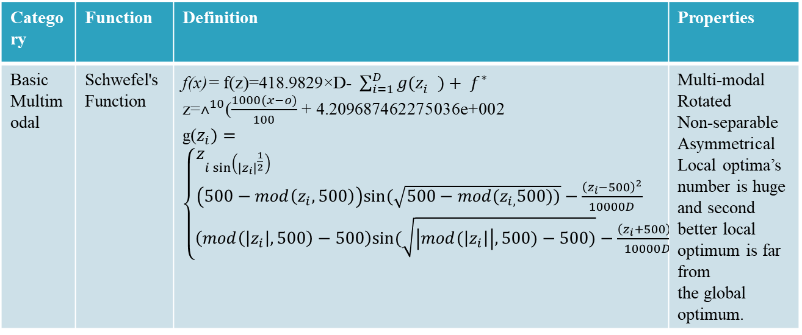
Test Functions
Category | Function | Definition | Properties
Basic Multimodal | Schwefel's Function | f(x)= f(z)=418.9829×D- $\sum_{i=1}^{D}{g(z_{i}^{}})+ f^{∗}$ z=$˄^{10}$($\frac{1000(x−o)}{100}$ + 4.209687462275036e+002 g($z_{i})=\left\{\begin{aligned}z_{i\sin\left({\left|z_{i}\right|}^{\frac{1}{2}}\right) if\left|z_{i}\right|≤500 } \\ \left(500−mod\left(z_{i},500\right)\right)sin⁡(\sqrt{500−mod(z_{i,}500))}−\frac{{\left(z_{i}−500\right)}^{2}}{10000D} ifz_{i}>500 \\ \left(mod\left(\left|z_{i}\right|,500\right)−500\right)sin⁡(\sqrt{\left|mod(\left|z_{i}\right|\right|,500)−500)}−\frac{{\left(z_{i}+500\right)}^{2}}{10000D} ifz_{i}<−500\end{aligned}\right.$ | Multi-modal Rotated Non-separable Asymmetrical Local optima’s number is huge and second better local optimum is far from the global optimum.

Slide 56
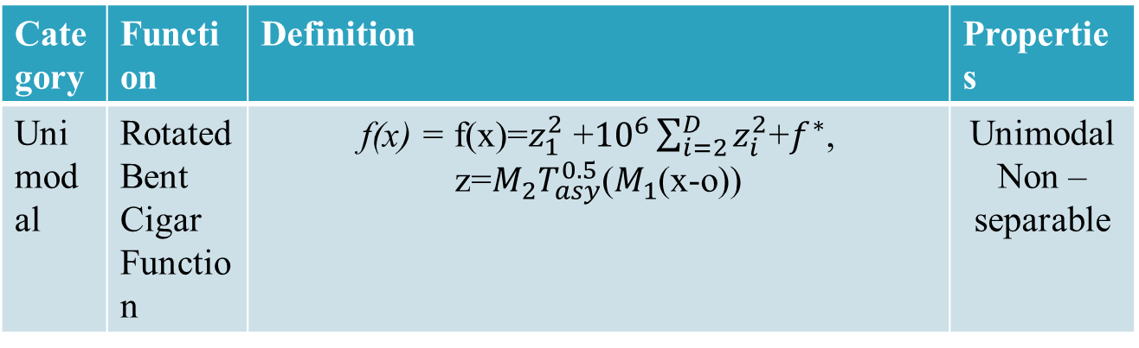
Test Functions
Category | Function | Definition | Properties
Unimodal | Rotated Bent Cigar Function | f(x) = f(x)=$z_{1}^{2}$ +${10}^{6}\sum_{i=2}^{D}{z_{i}^{2}}$+$f^{∗}$, z=$M_{2}T_{asy}^{0.5}$($M_{1}$(x-o)) | Unimodal Non – separable

Slide 57
Parameter Setting
Sr. No. | Parameters | Value
1 | Design Variables | 10, 30, 50
2 | Population Size | 100
3 | Number of Iterations | 10000
4 | Number of Function Runs | 51
5 | Total Functions | 28
Sr. No. | Performance Evaluation
1 | Mean
2 | Best
3 | Worst
4 | Standard Deviation
5 | t-Test
6 | Optimized value
7 | Number of evaluations
Table 2: Parameters Used
Table 3: Performance Evaluation

Slide 58
THANK YOU.

Slide 59
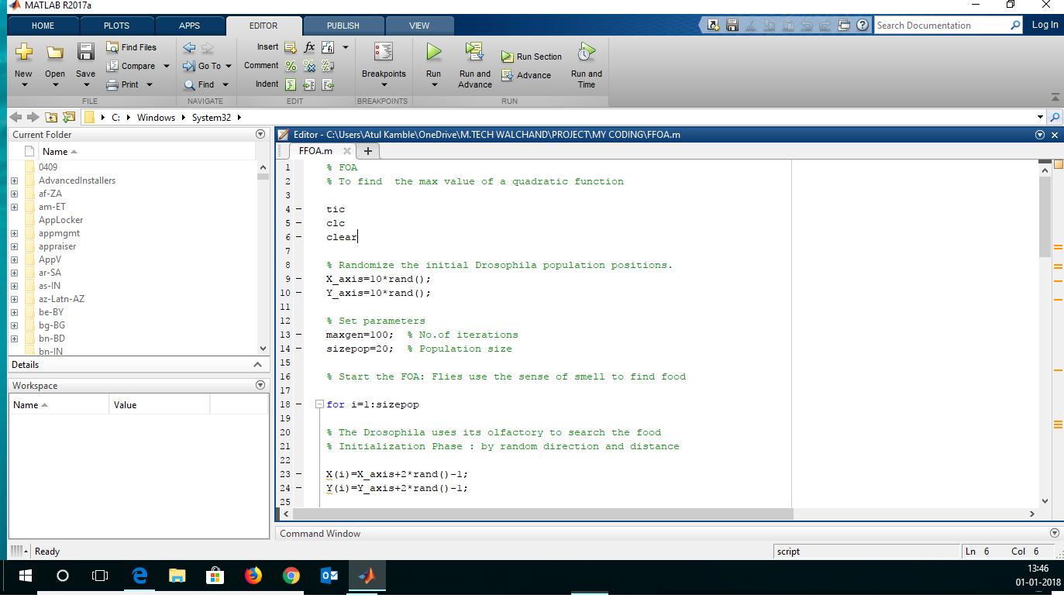
MATLAB CODE SCREENSHOT

